Slide 1
Data Structures and Algorithms
BSc. In Computing
Semester 5 Lecture 10
Lecturer: Dr. Simon McLoughlin

Slide 2

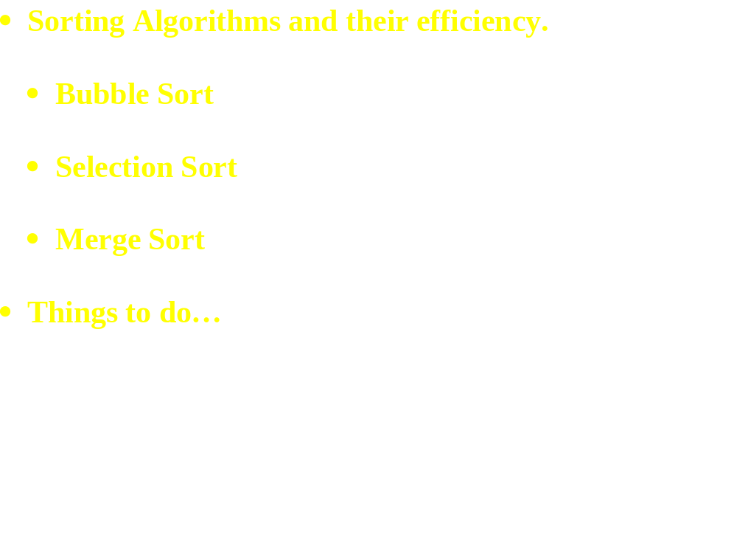
This Week:

Slide 3
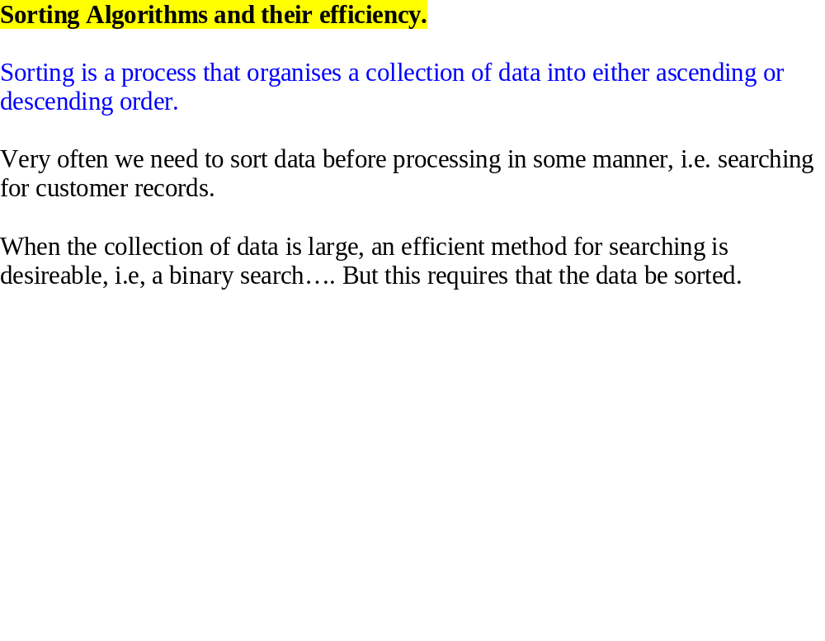

Slide 4
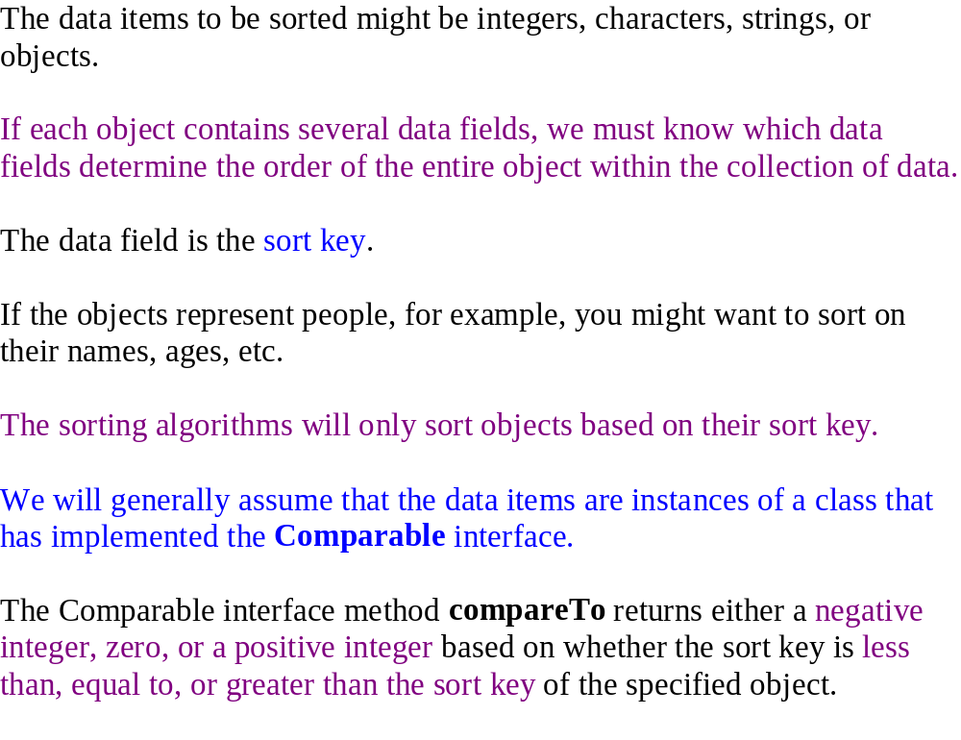

Slide 5
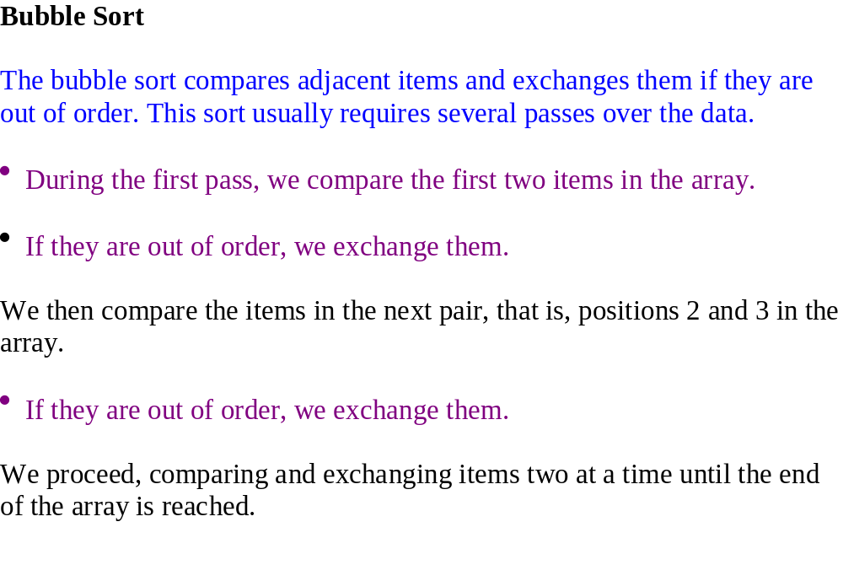

Slide 6
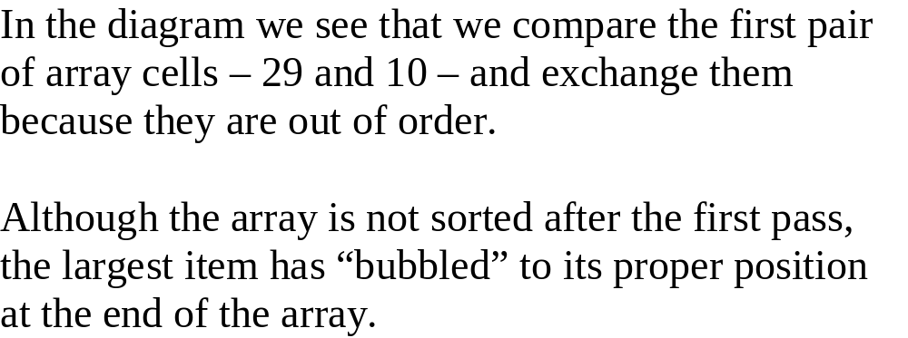
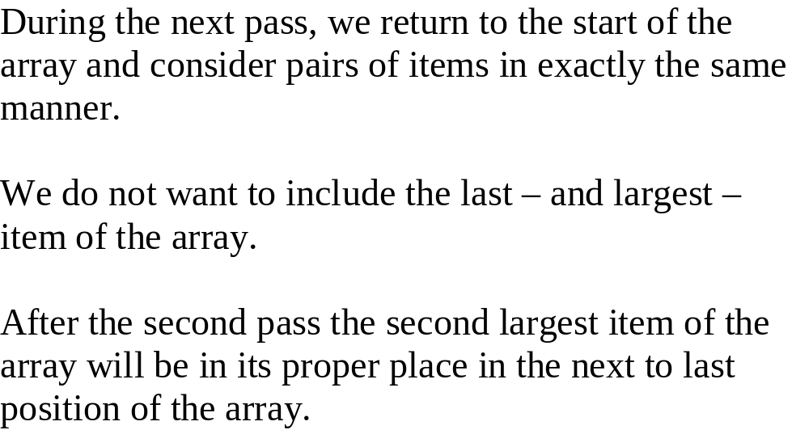
The first two passes of a bubble sort of an array of five integers
Pass 1
29
10
14
37
13
10
29
14
37
13
10
14
29
37
13
10
14
29
37
13
10
14
29
13
37
Pass 2
10
14
29
13
37
10
14
29
13
37
10
14
29
13
37
10
14
13
29
37

Slide 7
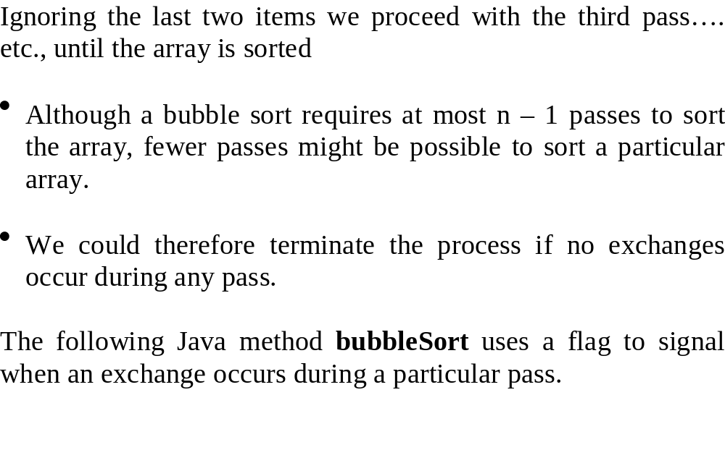

Slide 8
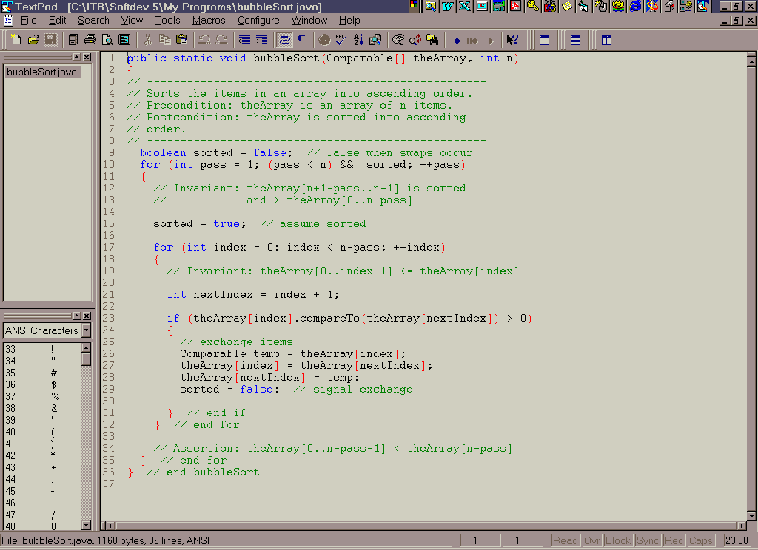

Slide 9
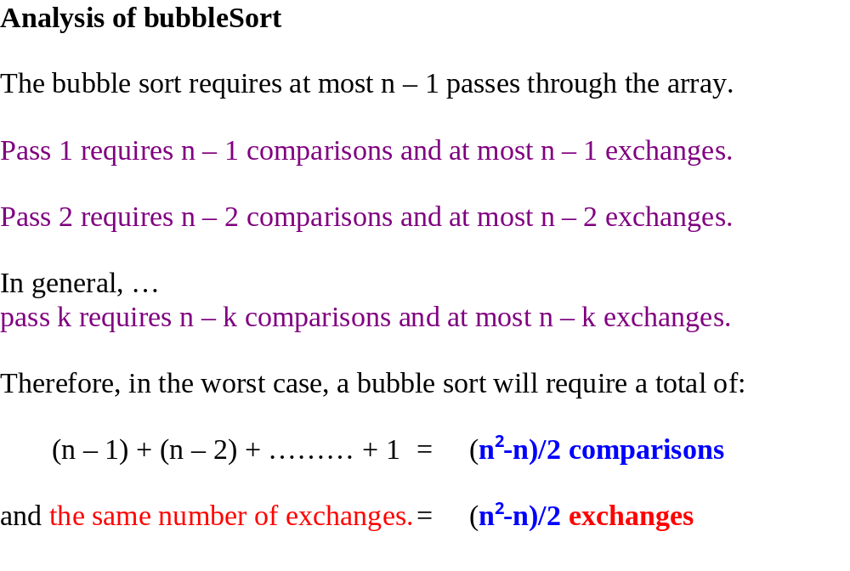

Slide 10
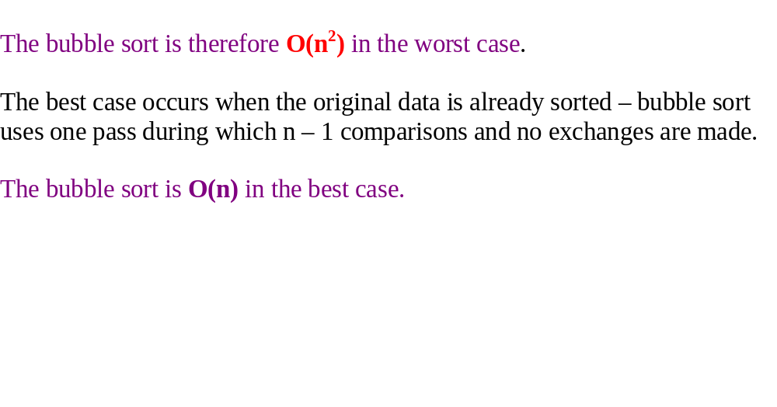

Slide 11
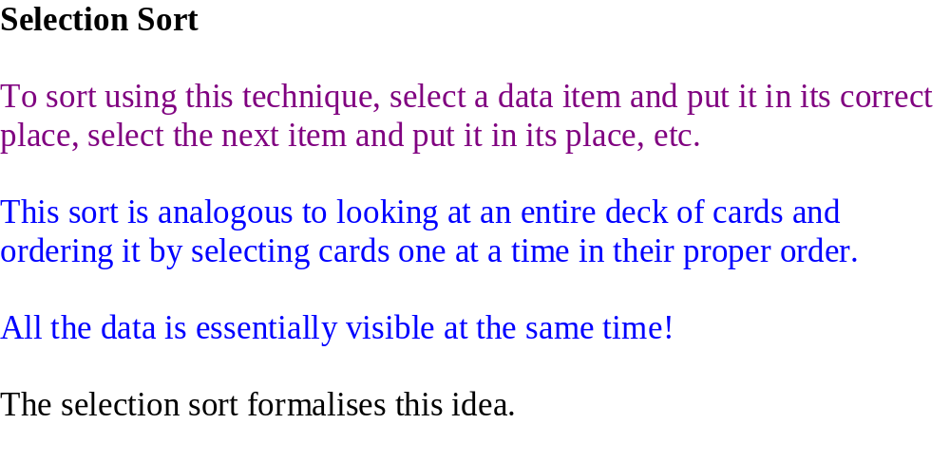

Slide 12
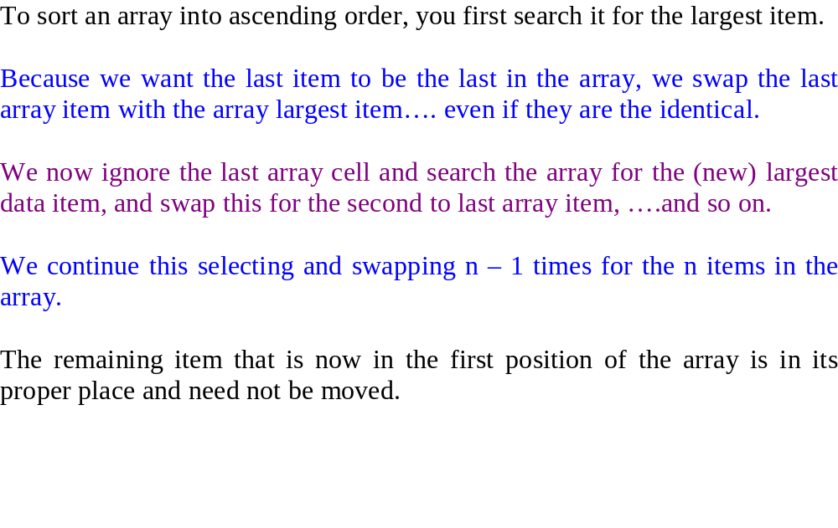

Slide 13
A Selection sort of an array of five elements
Initial array
After 1st swap
After 2nd swap
After 3rd swap
After 4th swap
29
10
14
37
13
29
10
14
13
37
13
10
14
29
37
13
10
14
29
37
10
13
14
29
37
Shaded elements are selected
boldface elements are in order

Slide 14
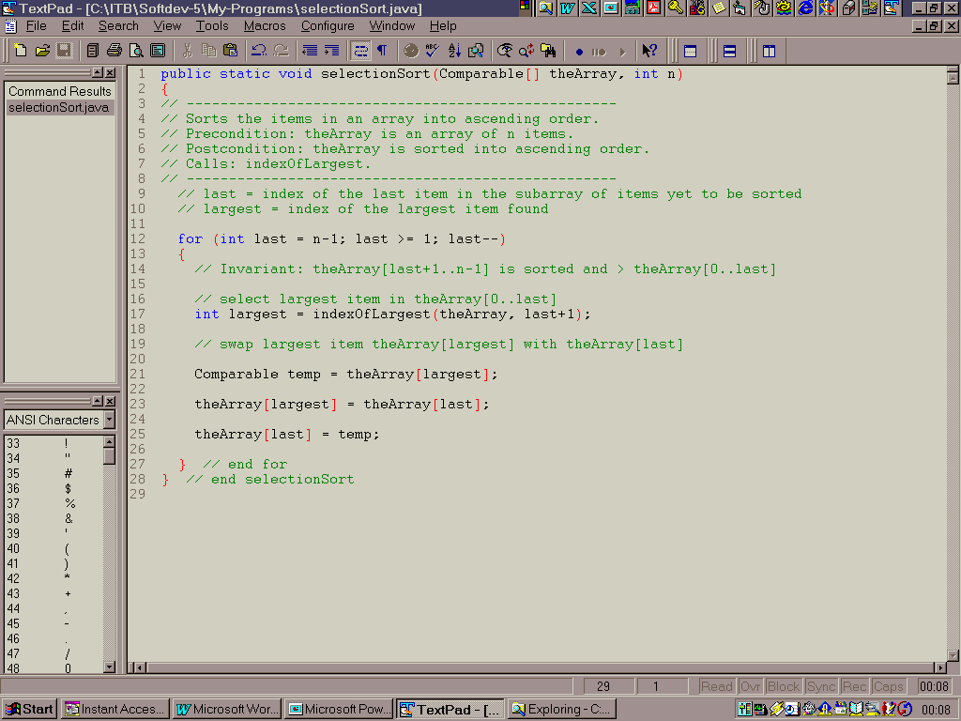

Slide 15
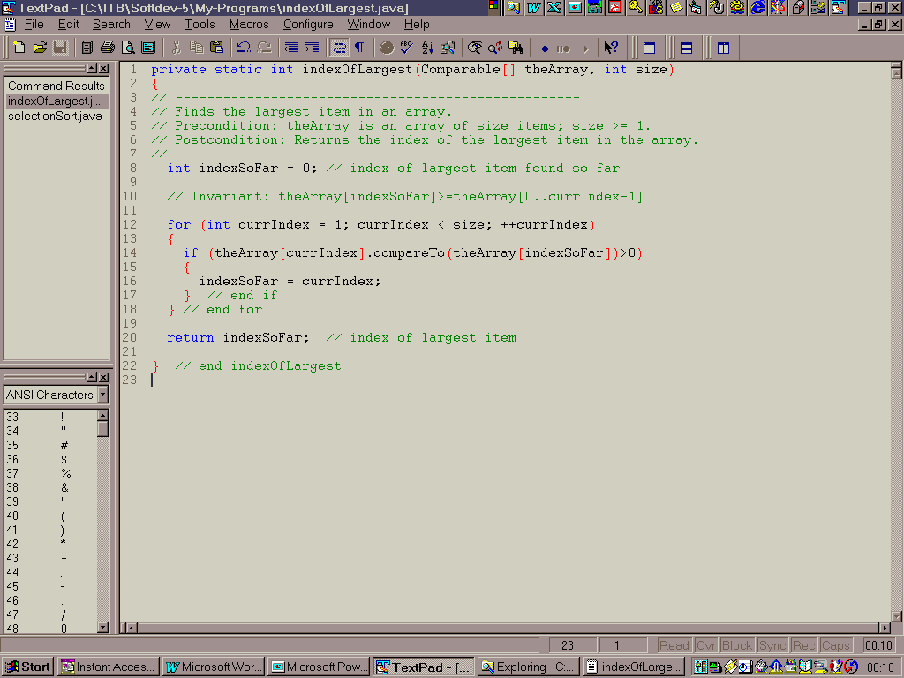

Slide 16
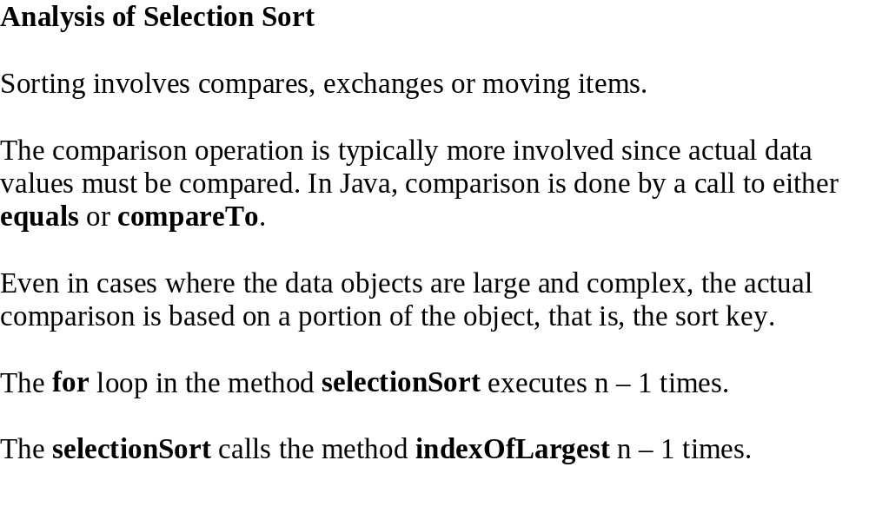

Slide 17
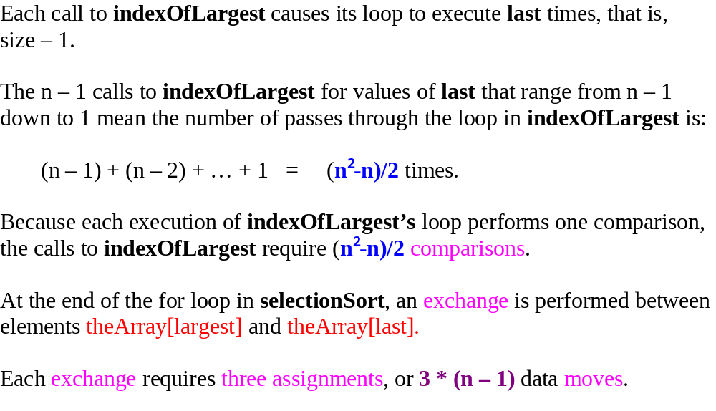

Slide 18
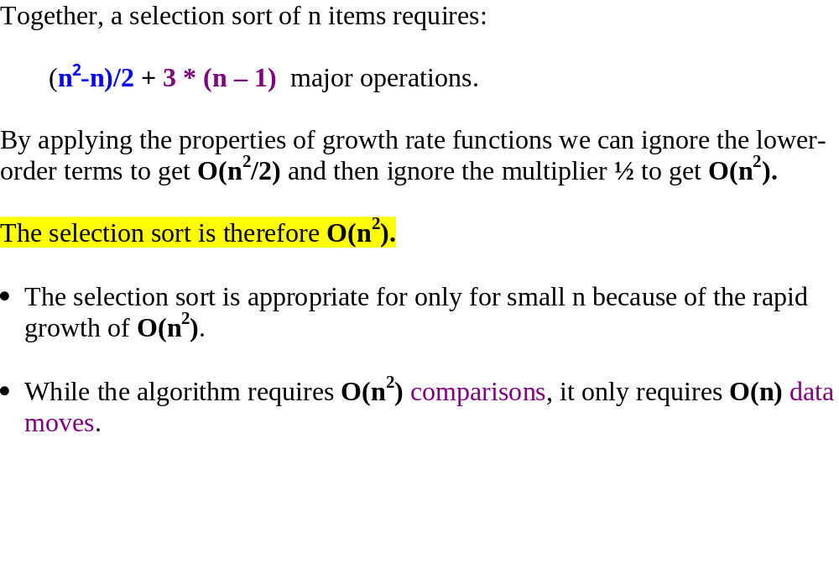

Slide 19
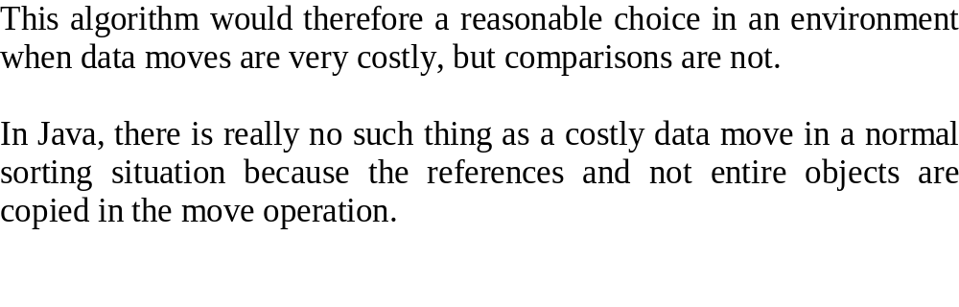

Slide 20
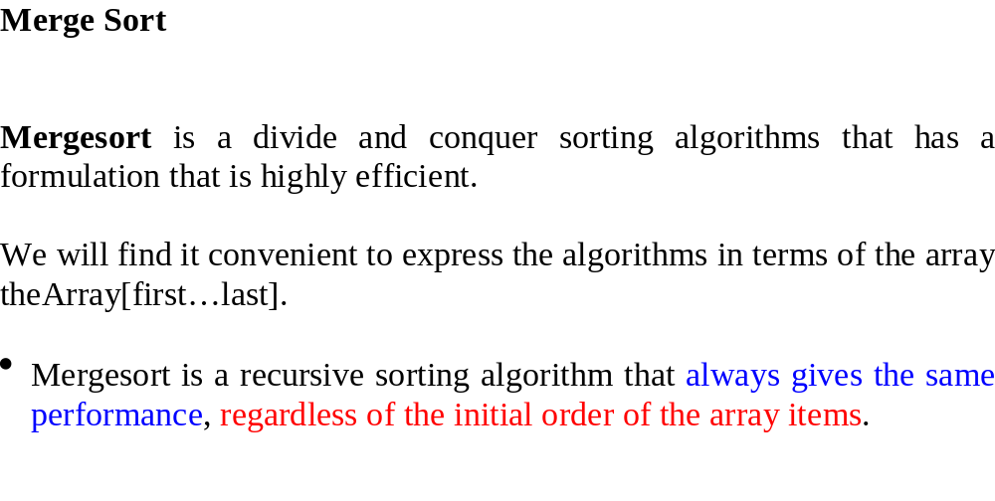

Slide 21
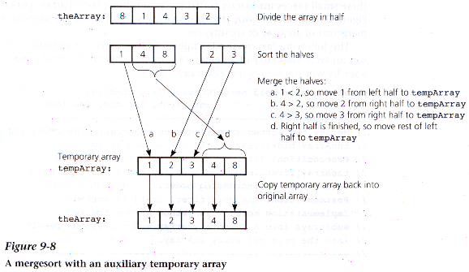
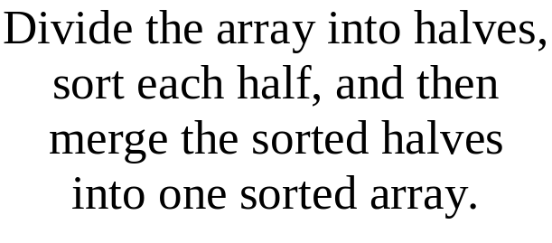
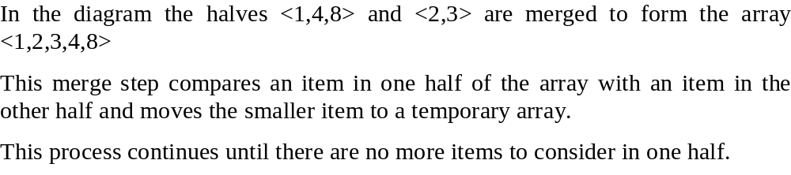

Slide 22
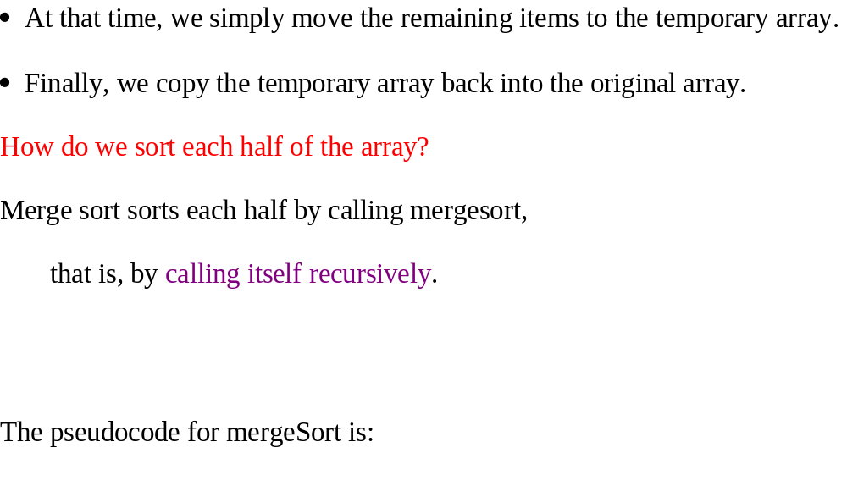

Slide 23
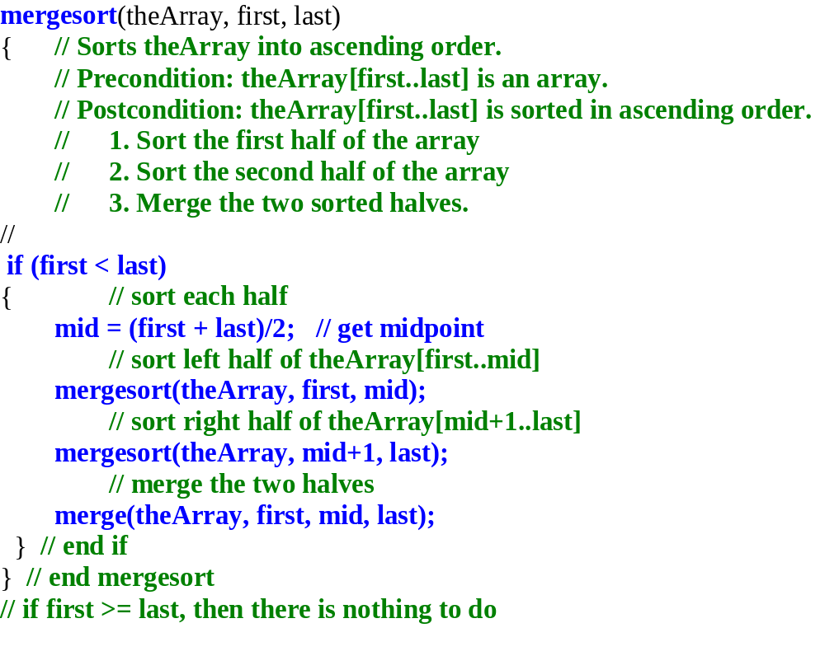

Slide 24
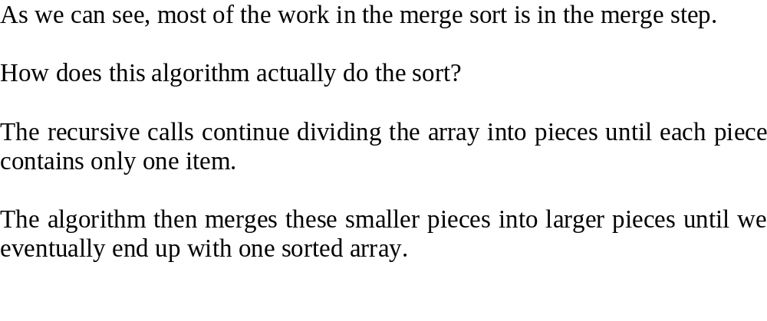
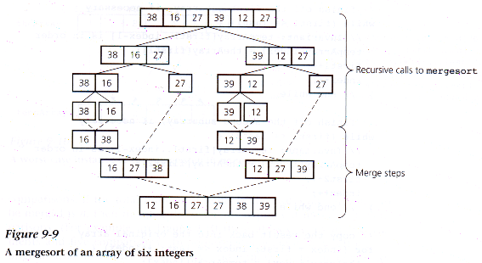

Slide 25
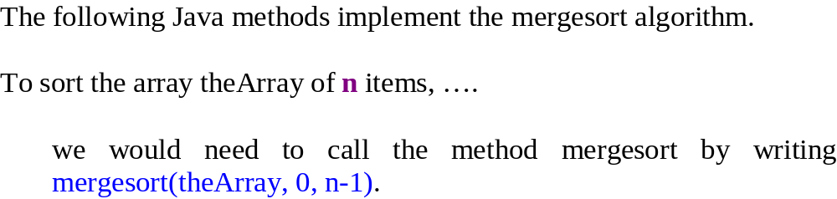

Slide 26
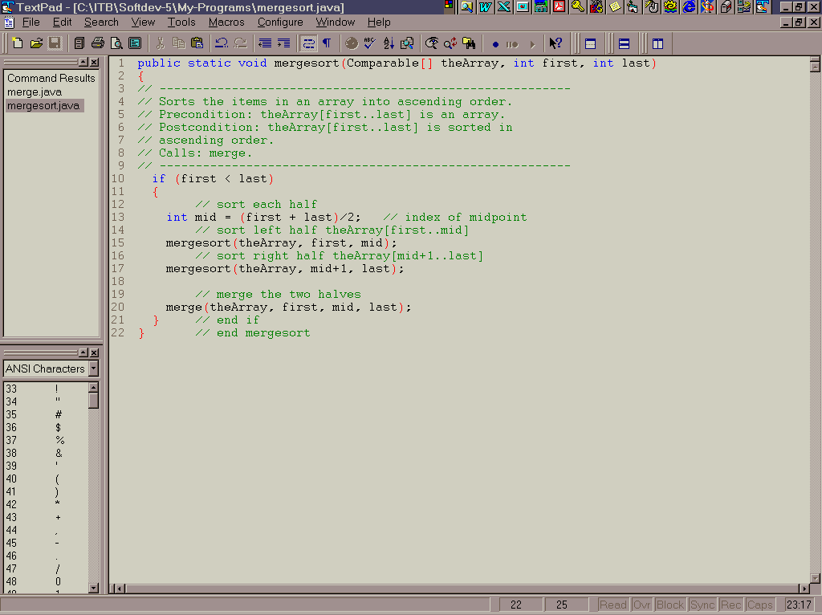
Mergesort
method

Slide 27
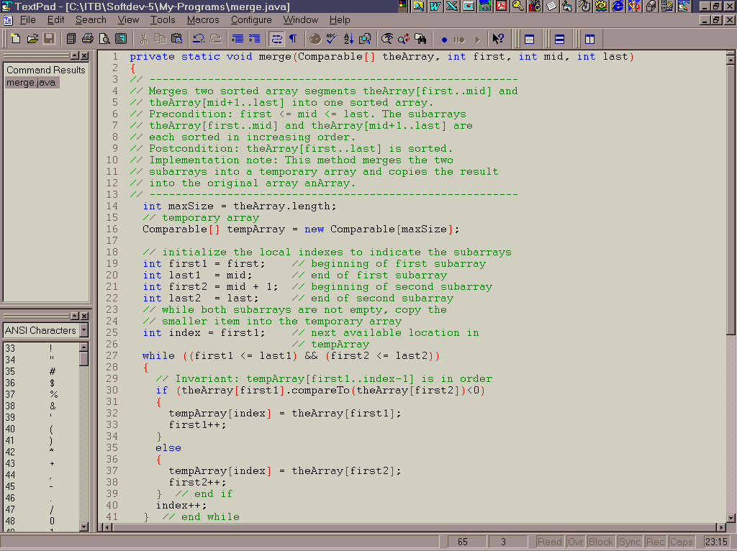
Merge
method

Slide 28
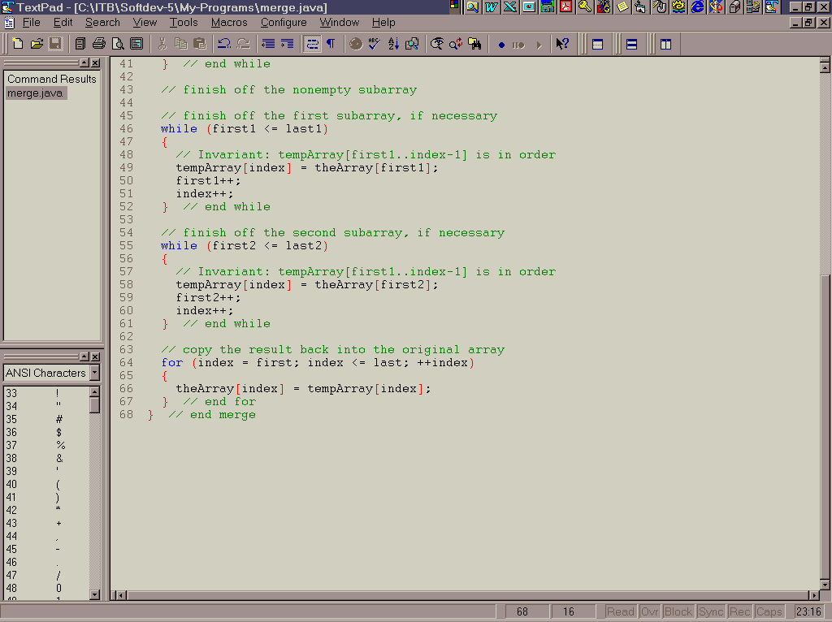

Slide 29
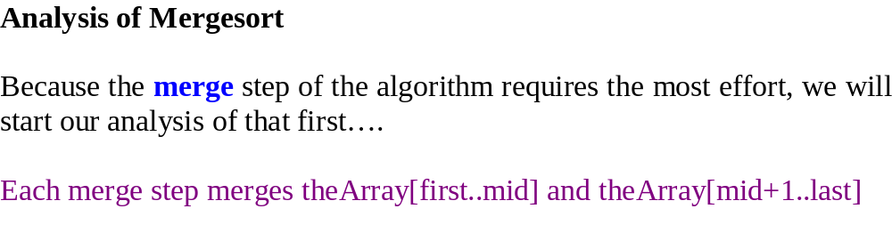
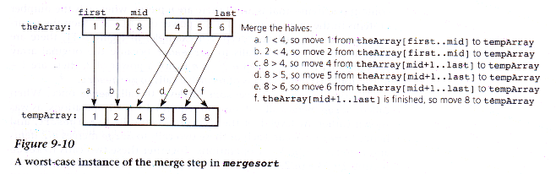

Slide 30
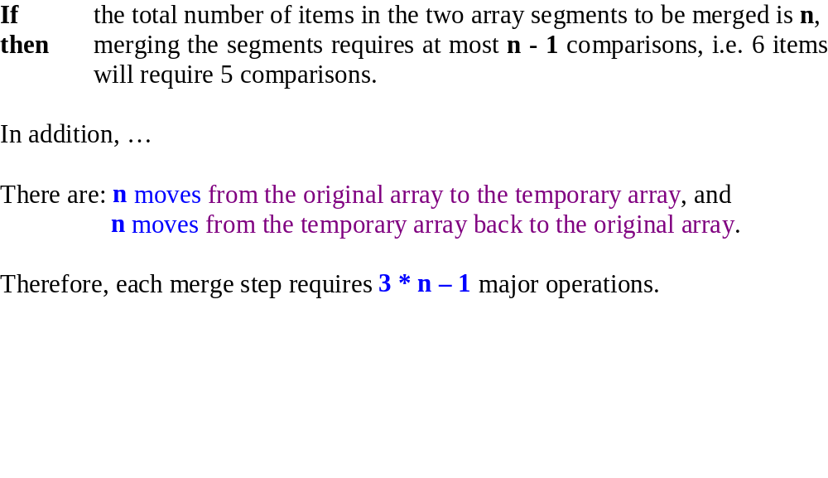

Slide 31
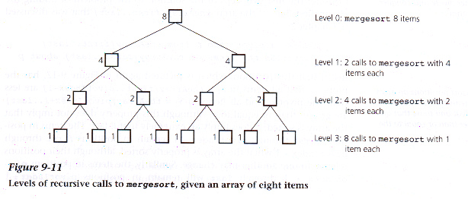
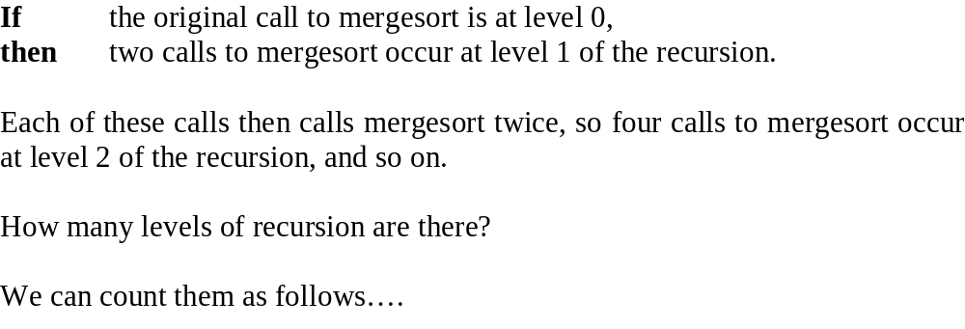

Slide 32
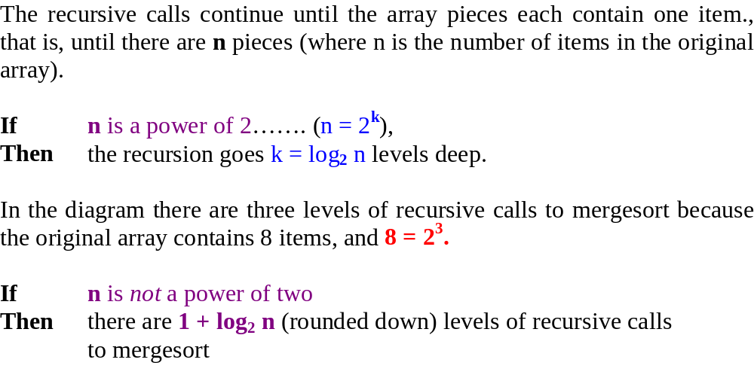

Slide 33
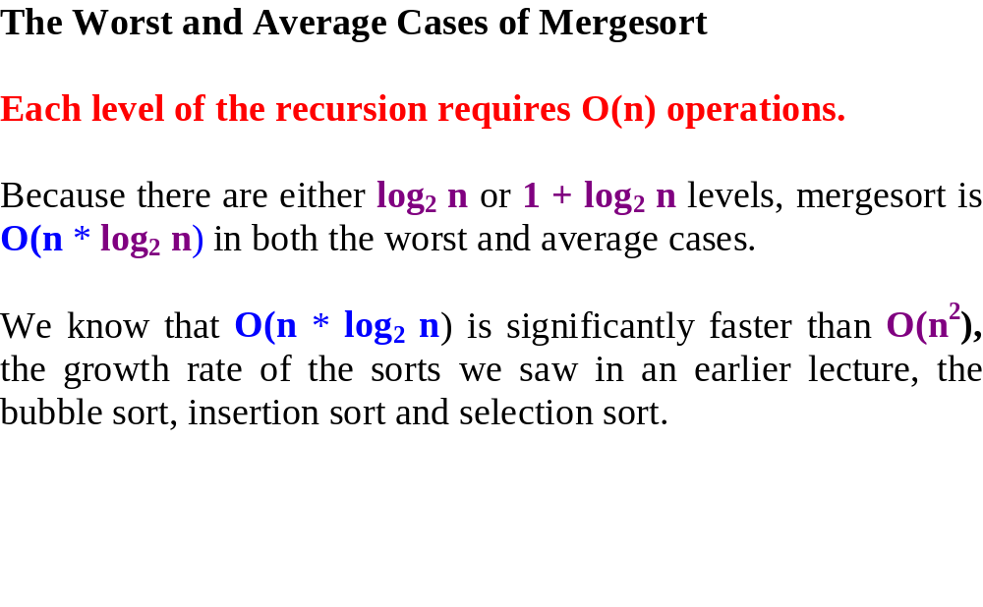

Slide 34
A comparison of Sorting Algorithms
The following table lists of a number of the major sorting algorithms.
We have studied bubble sort, selection sort, insertion sort, merge sort.
The other sorts are included to indicate how they compare to the sorts we
have studied.
Worst Case
Best Case
Selection sort
n
2
n
2
Bubble sort
n
2
n
2
Insertion sort
n
2
n²
Merge sort
n * log n
n * log n
Quick sort
n
2
n * log n
Tree sort
n
2
n * log n
Heap sort
n * log n
n * log n

Slide 35
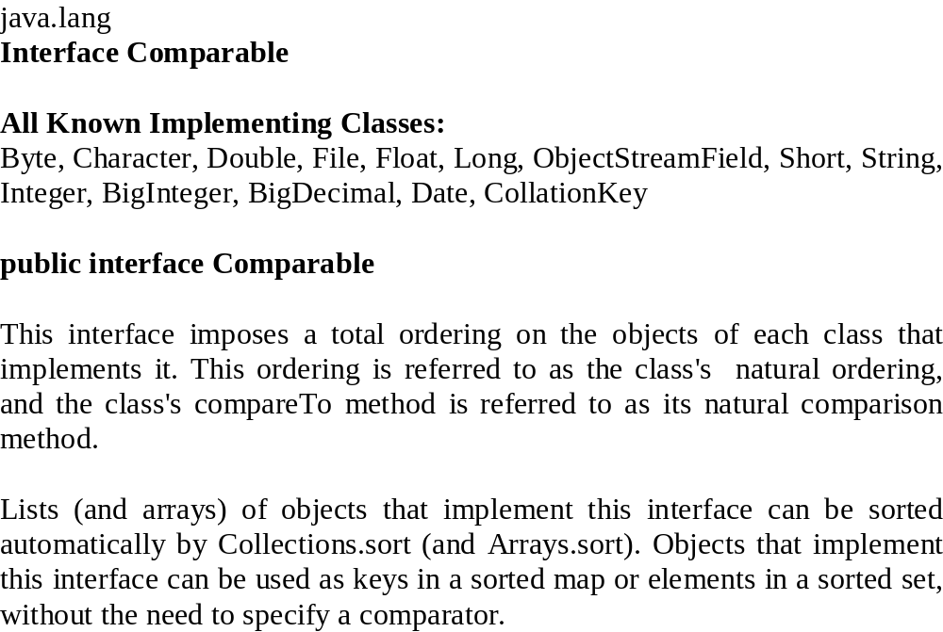

Slide 36
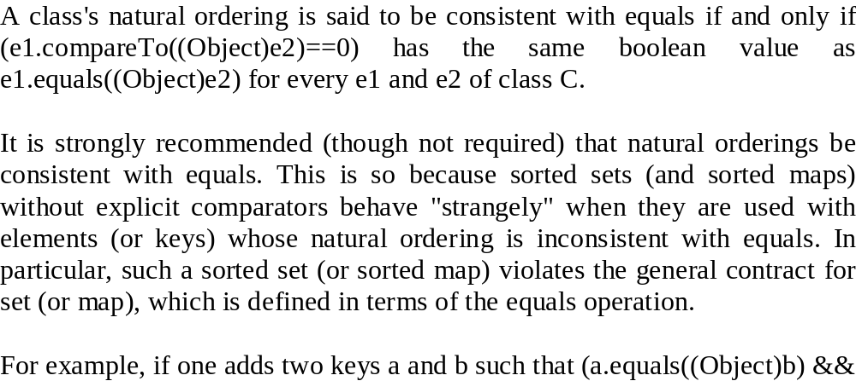

Slide 37
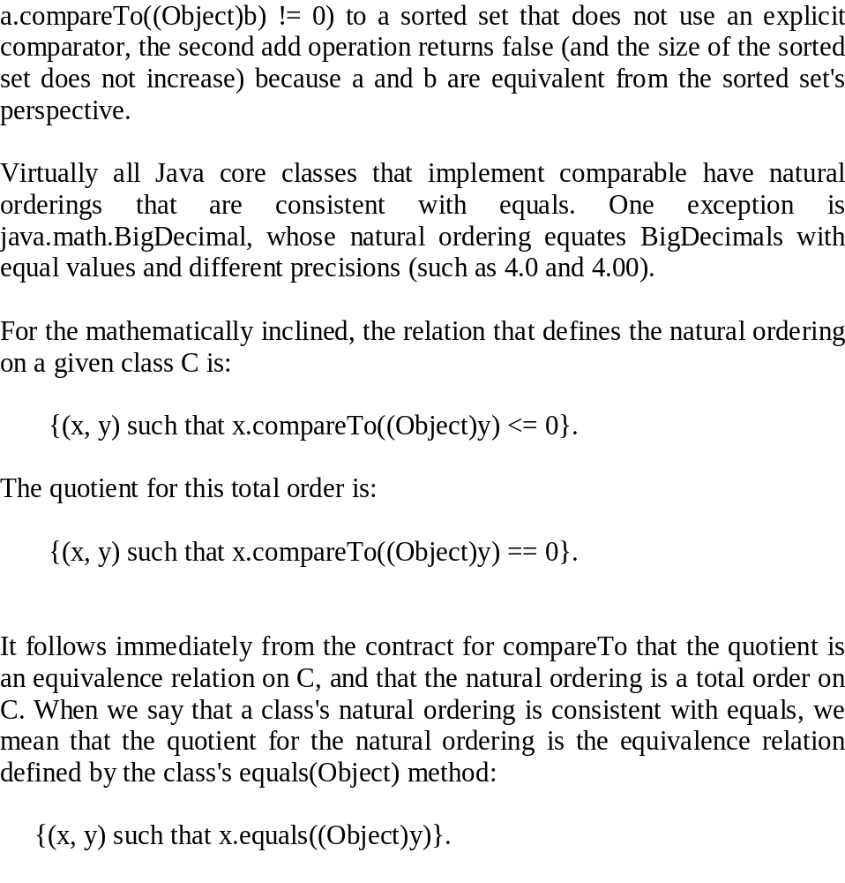

Slide 38
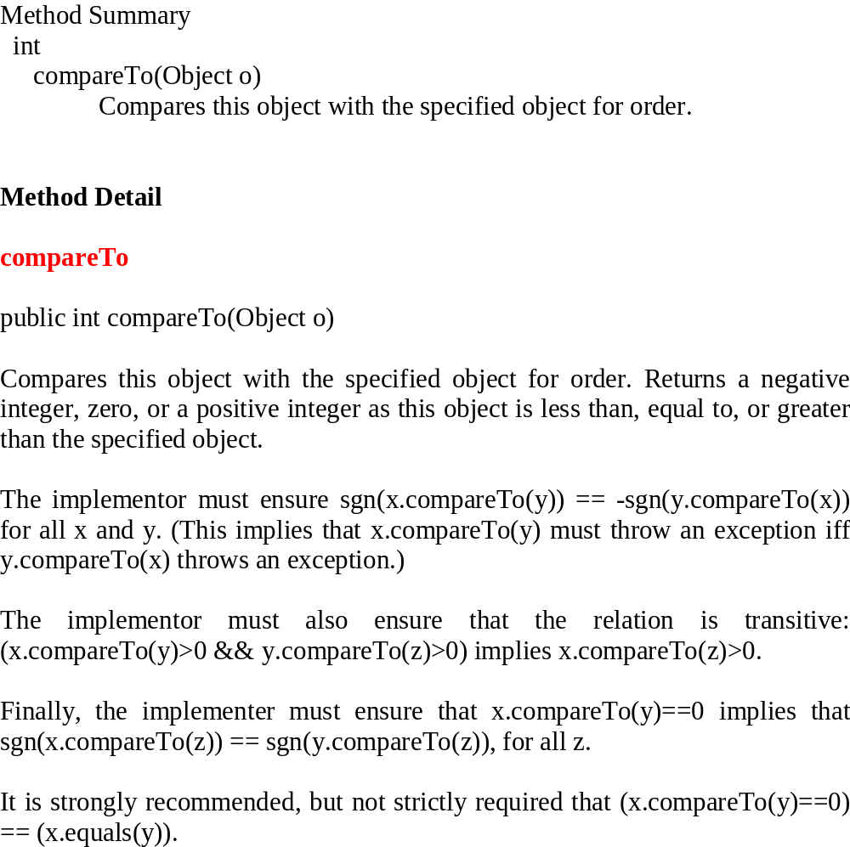

Slide 39
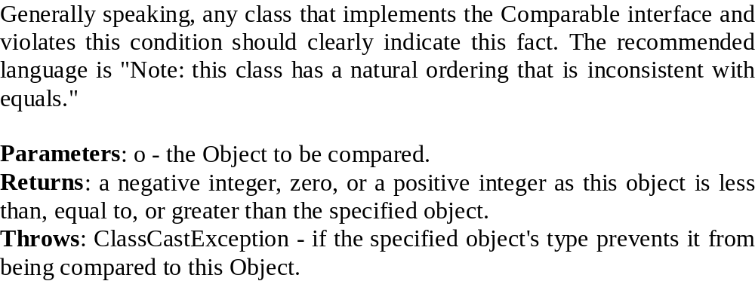

Slide 40
Programs to do this week:

Slide 41
Write a Java program to implement the mergesort
In your program, populate an array (size 200) with objects that implement the Comparable interface. Each object should only have one instance variable (an integer) and two methods, int compareTo (that compares it’s integer field with that of another parameter objects integer field) and getInt (that returns the integer value of the object that invoked it).
Print the array in a tabulated form in unsorted form,
in, for example, 20 columns x10 rows
Mergesort the array.
Print the array in a tabulated form in sorted form, as above.
Provide a heading to each display of the data.

